Slide 1

The Billing and Inventory System (BIS)
Speaker1: Zhang Xue Speaker2: Yu Zhirong Speaker3: Li Jiayin

Slide 2



Contents
1
Introduction
2
Diagram
3
Code

Slide 3
Billing and Inventory System (BIS)
Programming Language: Python
Framework: PyQt5
Database: SQLite3
Library: Pandas

Slide 4
I Introduction

Slide 5

Billing and Inventory System (BIS)
Python-based application that simplifies billing and inventory management processes within enterprises.
Utilize PyQt5 for the user interface and SQLite as a lightweight and serverless database system.
Offer separate interfaces for administrators, auditors, and customers.
Provide functionalities like customer management, transaction tracking, billing generation, and payment records management.
Simplicity, interactivity, and modularization for ease of use and code maintenance.

Slide 6
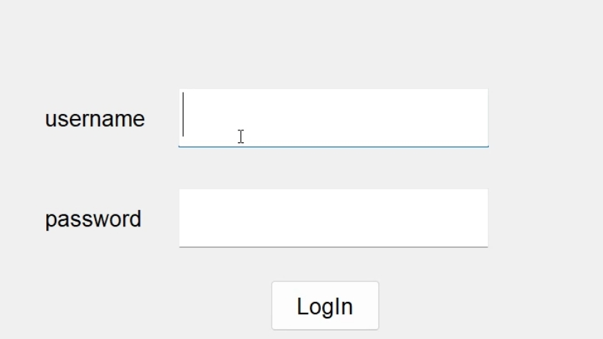
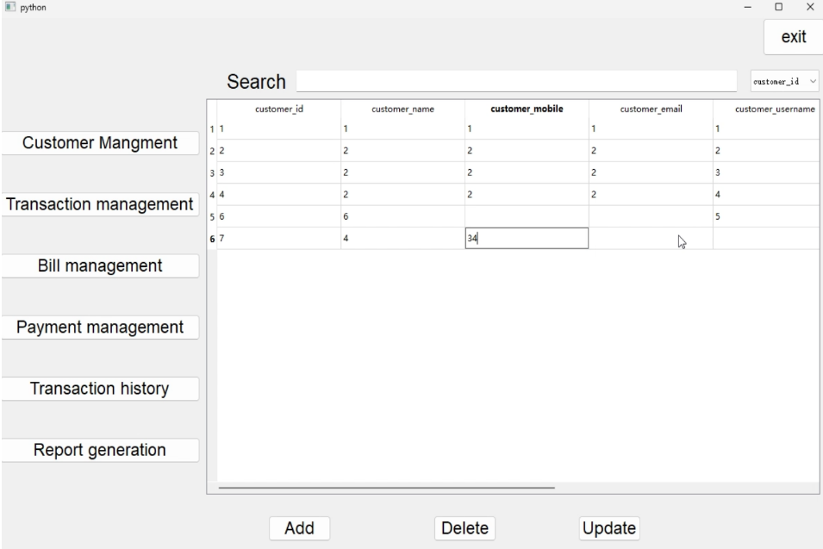
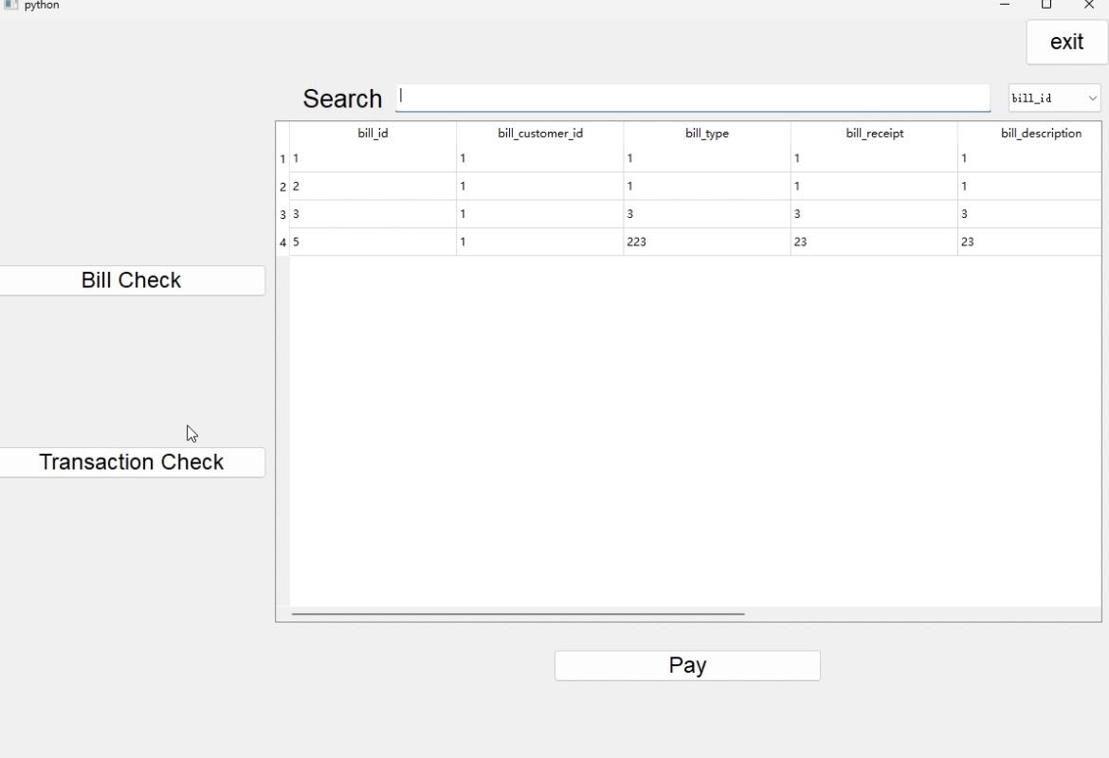
System Operation Process
The user starts the application and enters the main interface
The user enters the username and password
The Main Interface
The system authenticates and loads the appropriate user interface
The user enters the personal home interface
Administrator/Auditor Interface
Customer Interface
Notes:
a layered architecture for task scheduling and resource allocation
1.The task starts on the user's smart device, such as a smartphone or other IoT device. Applications on these devices generate various computing tasks, which may be data analysis, image processing, etc. Each task is evaluated by a machine learning model to decide whether it should be executed locally or uploaded to a more powerful server.
2. When tasks arrive at the MEC ("Mobile Edge Computing) server or cloud server, they are placed in a task queue. The task queue is like a waiting area, ensuring that all tasks are queued up in order to be processed.
3. cloud layer is at the top of this architecture and has more powerful processing capabilities. It is capable of handling computationally intensive tasks from below, leveraging advanced analytics techniques such as deep learning for data processing and decision support.
下面是具体的解释：
This figure shows a multi-layered intelligent task scheduling architecture for scheduling tasks between the cloud layer, edge computing layer (MEC), and device layer. This research mainly focuses on the edge computing layer (MEC) and the cloud layer. These scheduling algorithms mainly focus on how to efficiently allocate tasks in heterogeneous computing environments. The scheduling algorithm attempts to minimize the total time to complete all tasks (makespan). By predicting the completion time of each task and its dependencies, the scheduler can allocate tasks more intelligently, reduce waiting time, and improve overall efficiency.
Scheduler: The scheduler is not a specific processor or server, but an algorithm running on the server that is responsible for deciding which task should be executed by which processor. The scheduler evaluates each task's requirements and the status of available processors, then assigns the task to the most appropriate processor. For example, a task that requires a lot of GPU resources might be assigned to a server with corresponding hardware.

Slide 7
Module Task Operations
Administrator Interface
Customer Interface
Customer Module: Complete tasks of adding, deleting, searching, and updating customers and information
Trading Module: View transaction history and modify or delete transaction records.
Billing Module: Generate new bills, edit bills, search, and view bill details.
Payment Module: Add payment records and modify or view payment details.
Transaction History Module: View the history of all transactions, including detailed descriptions and related data.
Report Generation Module: Generate Excel reports of customers, transactions, and bills for review or record keeping.
Exit System Module: The administrator exits the system after completing the operation.
Bill Viewing Module: View details of the bill.
Transaction Viewing Module: View the transaction history and details.
Payment Module: Select the payment type.
Exit System Module: The customer exits the system after completing the operation.
Auditor Interface
They can see all customer information, each customer's bills and transactions, and payments, and can export Excel files but cannot change them.
Notes:
The algorithms introduce a two-phase approach: task prioritization and processor selection, aiming to minimize the scheduling length.
The HEFT algorithm optimizes task scheduling by considering the earliest completion time of each task and the performance of the processor. In a cloud tier environment, it allocates tasks to servers that can complete those tasks fastest.
The PPTS algorithm adds a predictive cost matrix (PCM) based on HEFT, which can more accurately estimate the data transmission cost and processing time between tasks.
(In the cloud, this predictive analytics can help schedulers allocate resources more efficiently, especially when tasks have complex dependencies.)
3. A unique feature is its ability to "look ahead" by considering the "out-degree" of tasks during the prioritization phase and adopting a "downward-upward" approach during the processor selection phase.

Slide 8
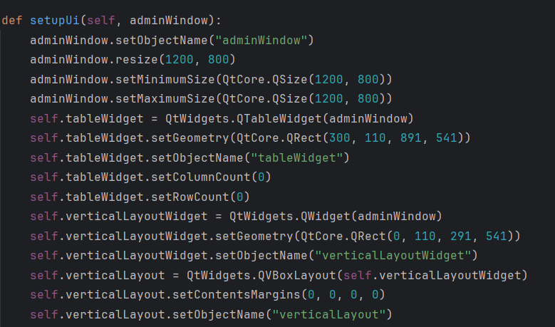
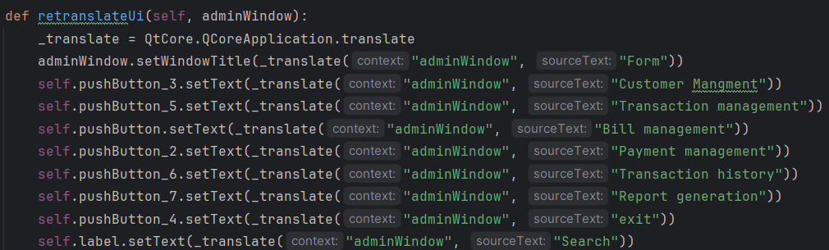
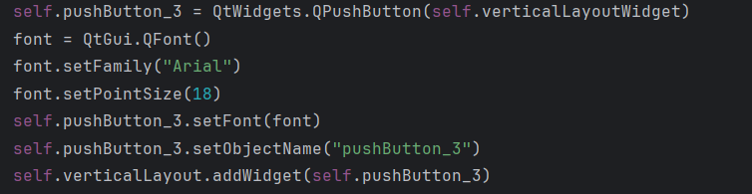
GUI Design
Initial Layout and Properties
Set the Translated Text
Push Button Creation
Notes:
The algorithms introduce a two-phase approach: task prioritization and processor selection, aiming to minimize the scheduling length.
The HEFT algorithm optimizes task scheduling by considering the earliest completion time of each task and the performance of the processor. In a cloud tier environment, it allocates tasks to servers that can complete those tasks fastest.
The PPTS algorithm adds a predictive cost matrix (PCM) based on HEFT, which can more accurately estimate the data transmission cost and processing time between tasks.
(In the cloud, this predictive analytics can help schedulers allocate resources more efficiently, especially when tasks have complex dependencies.)
3. A unique feature is its ability to "look ahead" by considering the "out-degree" of tasks during the prioritization phase and adopting a "downward-upward" approach during the processor selection phase.

Slide 9
II Diagram

Slide 10
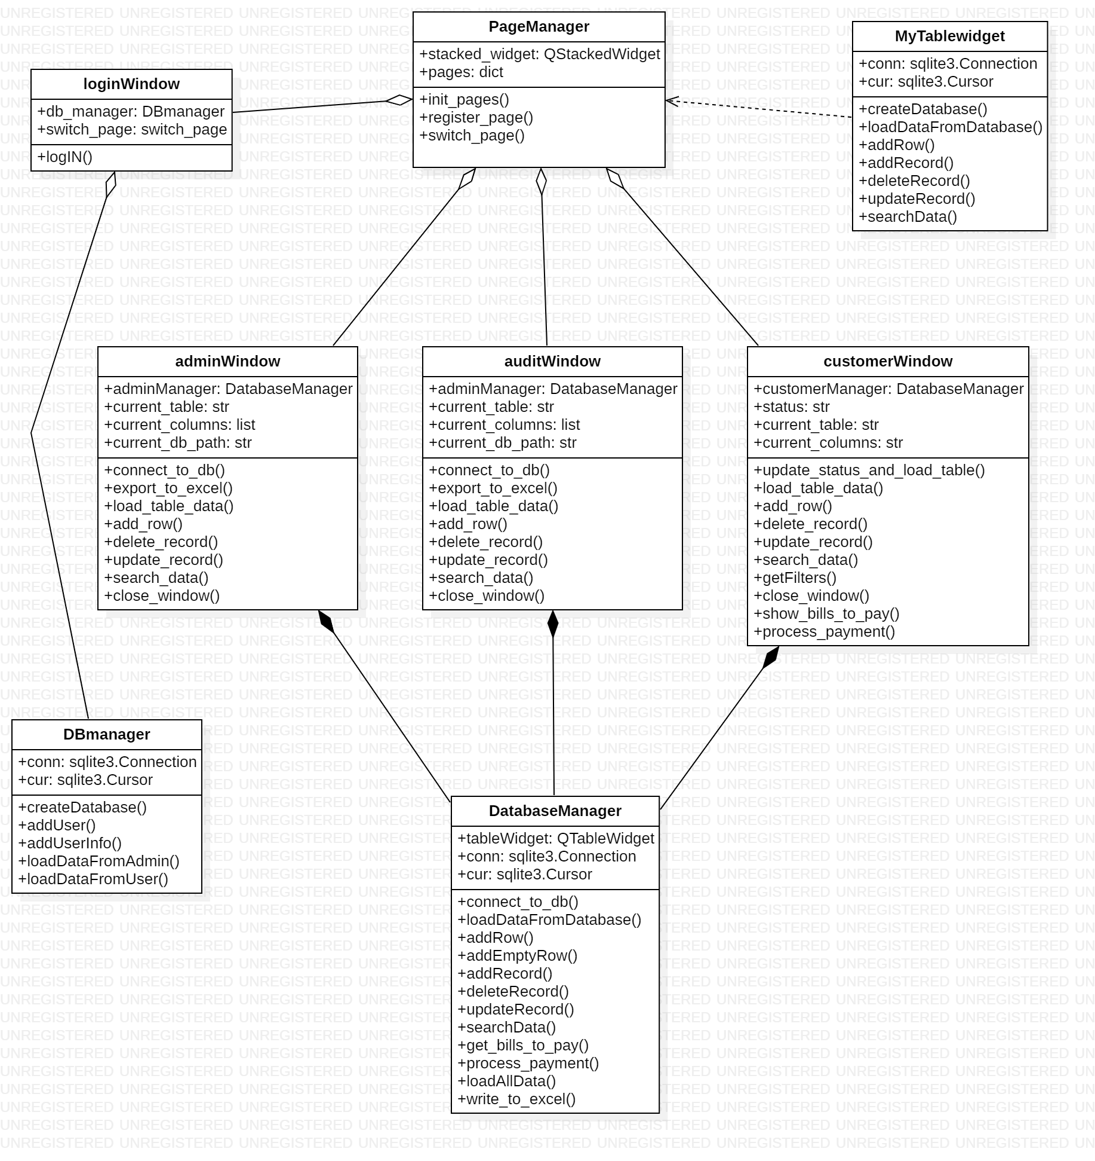
ClassDiagram
Notes:
So before explain our project in detail, let me first introduce you to our general framework using a few diagrams.
First let’s see the class diagram.
In our project, we mainly have 9 classes.

Slide 11
ClassDiagram
Notes:
For PageManager class, This class is responsible for managing the different pages within our application, including adminWindow、auditWindow and customerWindow.
And MyTableWidget class manages the interaction with the SQLite database. It includes methods for creating the database, loading data, adding, deleting, and updating records.

Slide 12
ClassDiagram
Notes:
Moving on, we have three window classes: **adminWindow**, **auditWindow**, and **customerWindow**. Each of these classes is managed by a respective `DatabaseManager` instance, and they share similar functions but cater to different user roles.
For example, adminWindow class allows administrators to interact with the database. It includes methods for connecting to the database, loading and updating data, adding and deleting records, and exporting data to Excel.
And auditWindow class, this class is similar to `adminWindow` but focuses on audit-related tasks.
and similarly, customerWindow class is tailored for customer interactions. It includes methods for updating statuses, loading and searching data, and processing payments.

Slide 13
ClassDiagram
Notes:
At the core of our database interactions is the **DBManager** class. This class provides methods for creating the database, adding users, loading data from different sources, and performing CRUD operations.
Finally, we have the **DatabaseManager** class, which acts as a general manager for our database operations. It includes methods for connecting to the database, loading data, adding, deleting, and updating records, as well as exporting data to Excel.

Slide 14
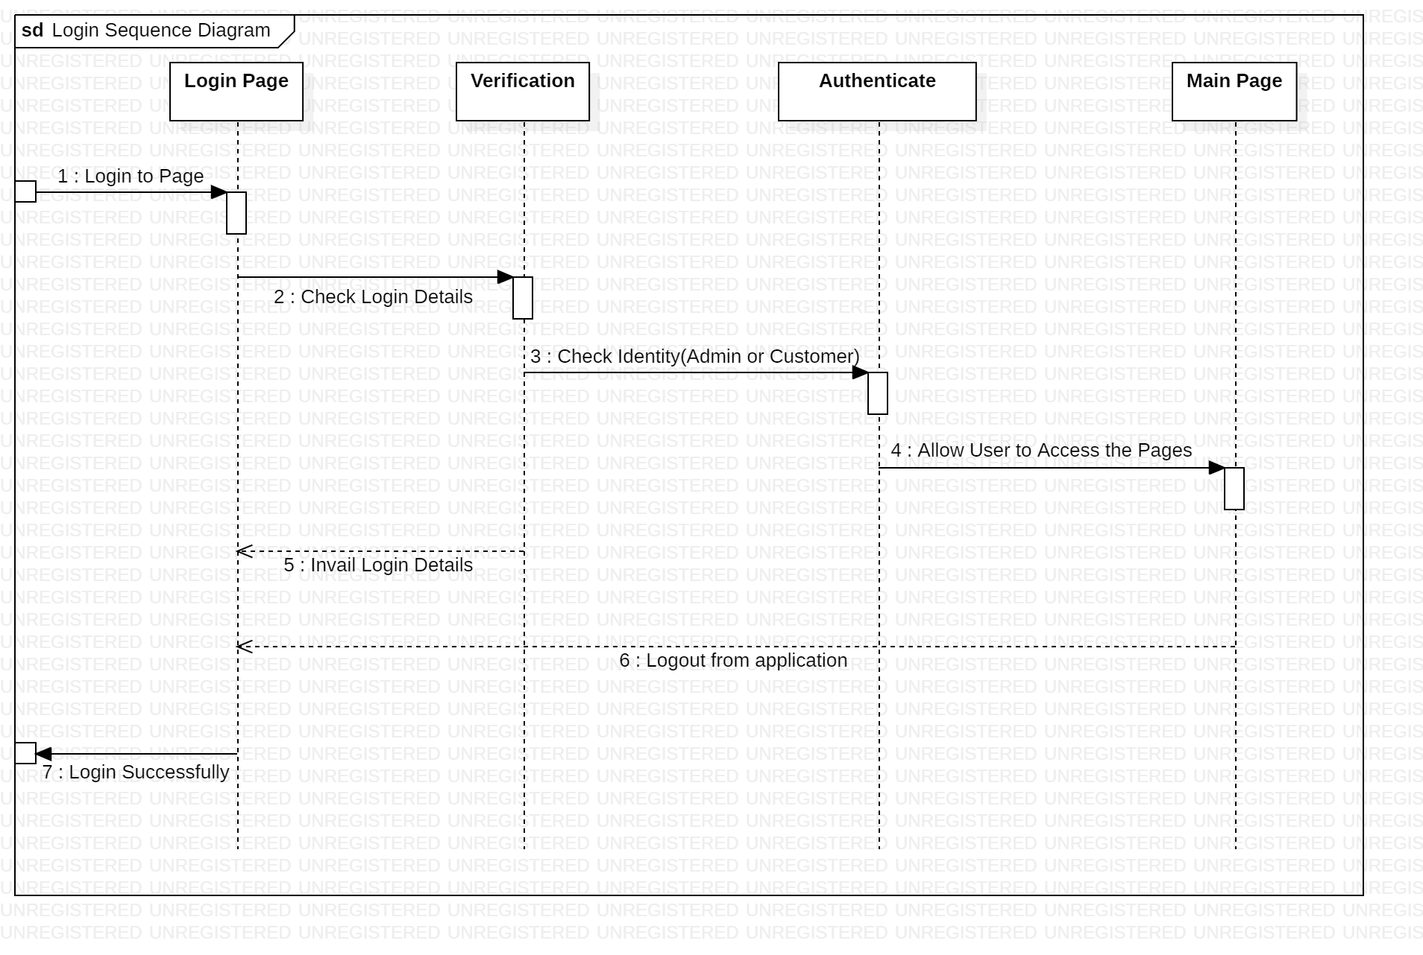
Login Sequence Diagram
Notes:
Next let’s see several sequence diagrams to understand our project flow.
First for the login sequence diagrams,
In the login page, the user first should enter the username and password.
And then The system will check the login details, if invalid, it will back to login page.
If valid, it will check the role of the user to see if the user is admin, audit, or customer.
and redirect to the corresponding main page. until the user exits the system

Slide 15
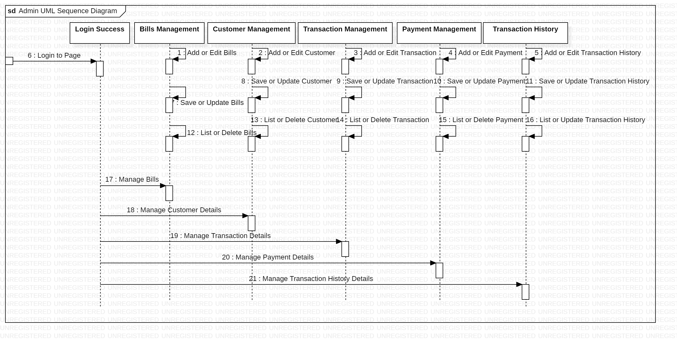
Admin UML Sequence Diagram
Notes:
if the user is admin, there are five options for what to do next
Manage Bills, Customer Details, Transaction Details, Payment Details, and Transaction History Details.
And for each allows admin for a series of actions, for example,
For transaction history, the admin have permissions to add, delete, update, edit and so on.

Slide 16
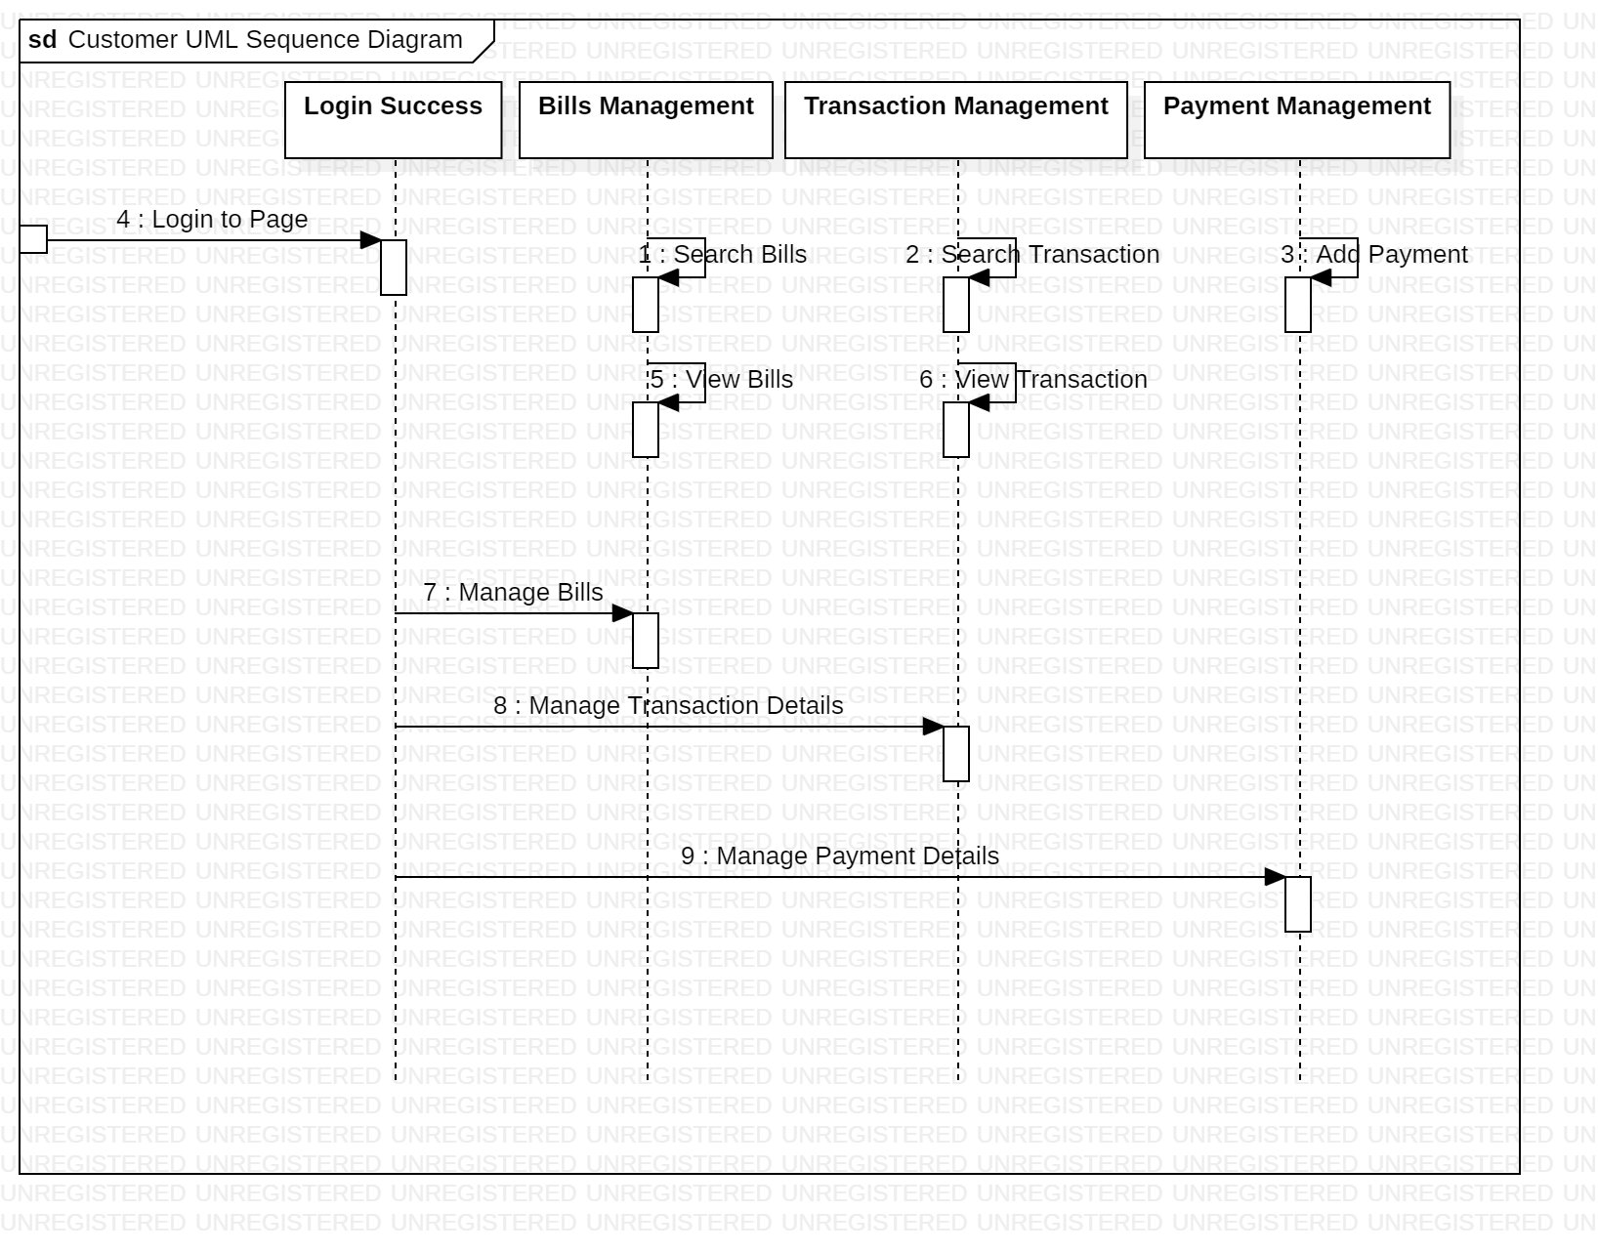
Customer UML Sequence Diagram
Notes:
And if the user is customer,
Their permissions will be limited and they can only view and search bills and transactions and add payments.

Slide 17
III Code

Slide 18

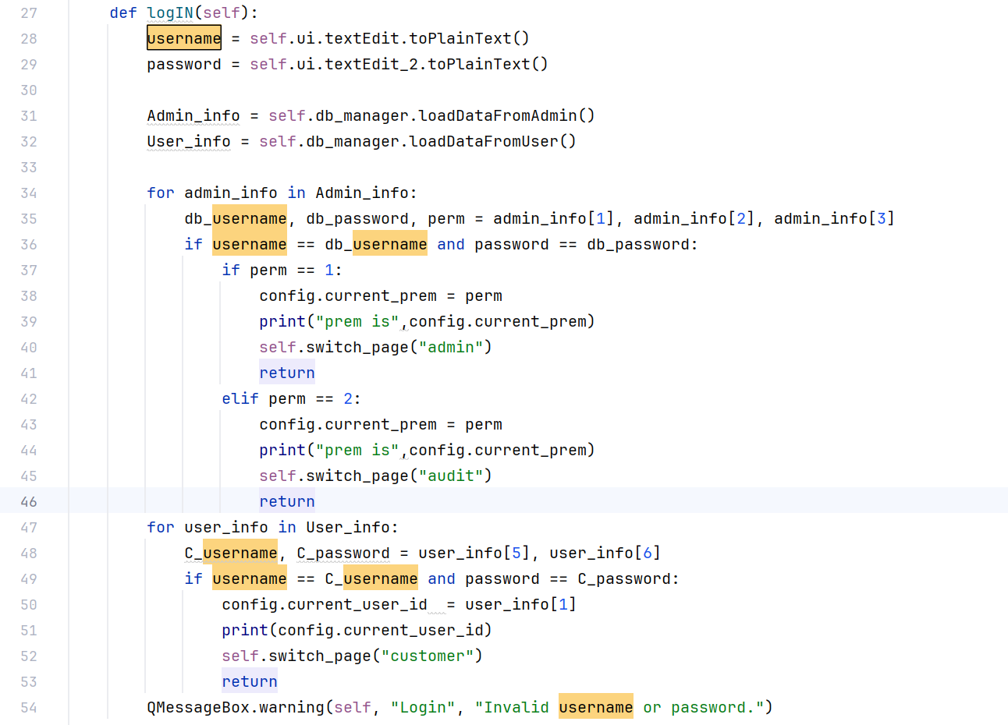
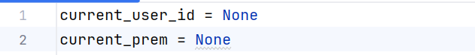
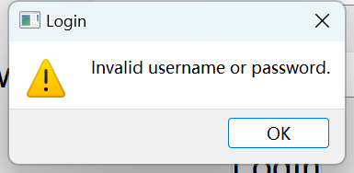
Notes:
Username and password verification
If the user's permission (perm) is 1, it means that this is a first-level administrator.
Store the current permission value (perm) in the global variable current_prem of the config module
Use return to end the execution of the logIN method
Iterate through the user information
stored in the global configuration
If the username or password is invalid, a warning message box is displayed to prompt the user.

Slide 19
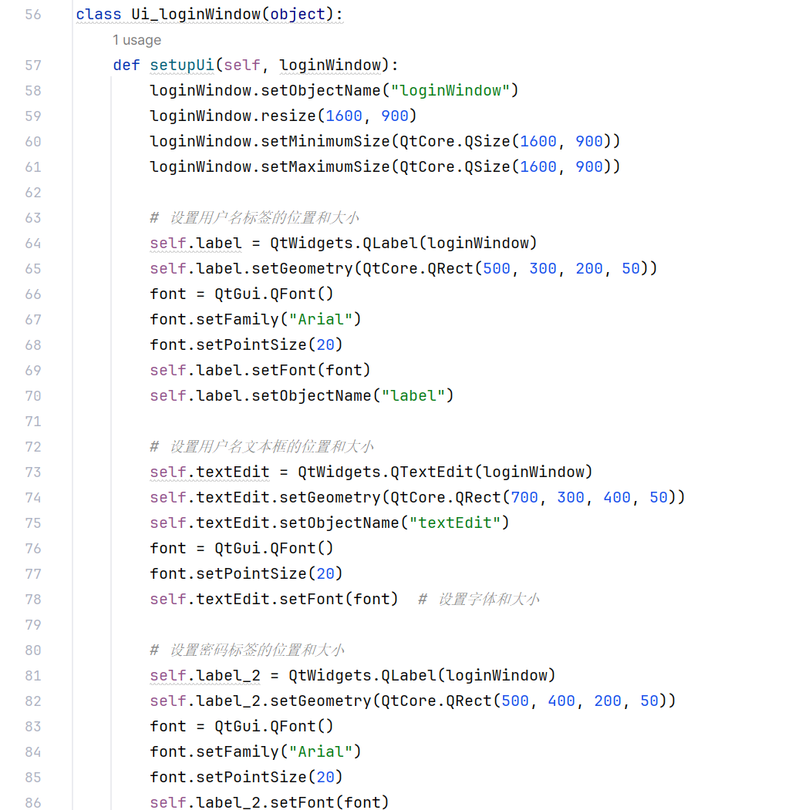
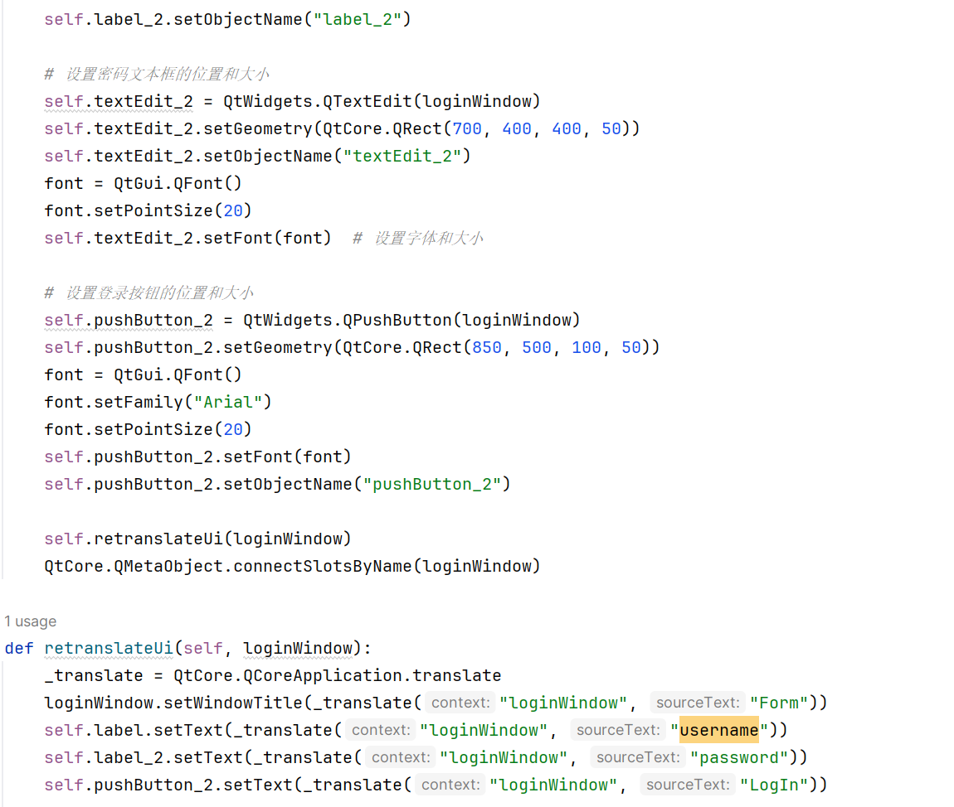
Notes:
Set the position and size of various elements of the login window

Slide 20

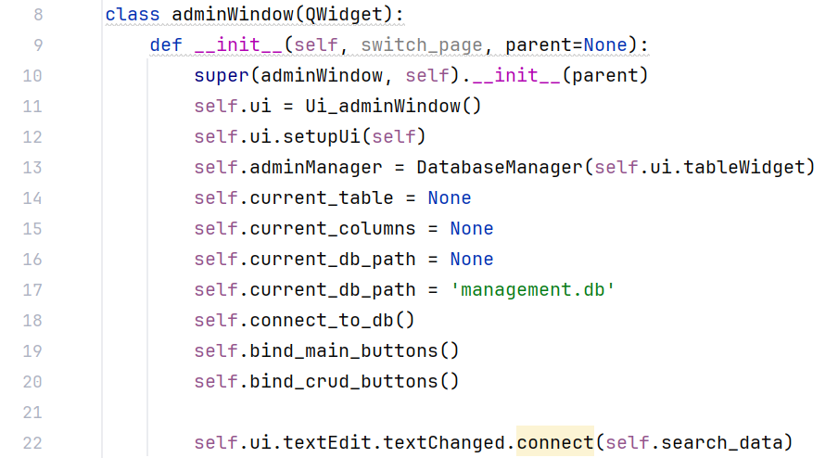
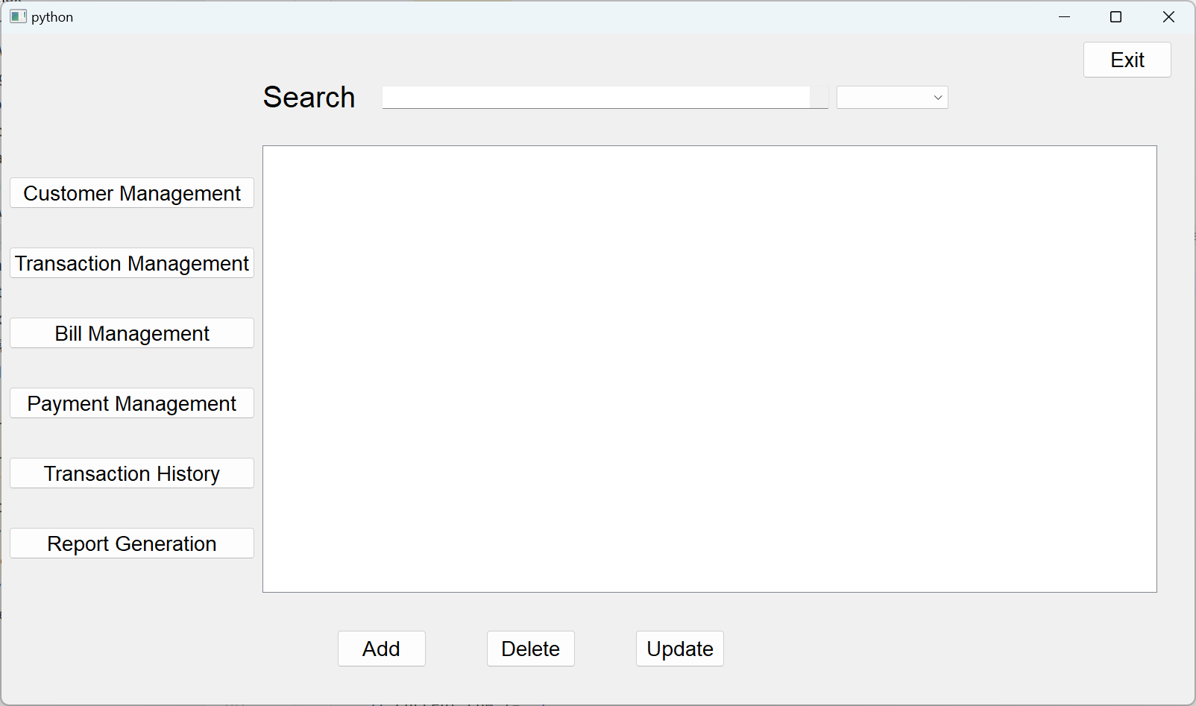
bind the main function buttons to the slot function
add, delete, and update buttons to the slot function
Notes:
初始化 adminWindow 类，调用父类的构造函数。
创建 Ui_adminWindow 实例并设置用户界面。
创建 DatabaseManager 的实例，用于管理和操作数据库。
self.ui.tableWidget 用于显示数据。
初始化当前表名、列名和数据库路径的变量。
调用 bind_main_buttons 方法，将主要功能按钮与槽函数绑定。
调用 bind_crud_buttons 方法，将增删改按钮与槽函数绑定。
Call the bind_main_buttons method to bind the main function buttons to the slot function.
Call the bind_crud_buttons method to bind the add, delete, and modify buttons to the slot function.
When the content in the search box changes, the search_data method is automatically called to search.

Slide 21
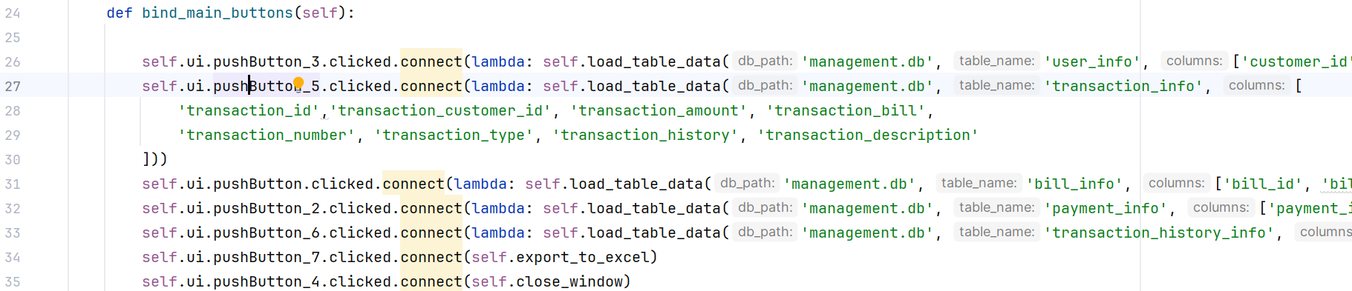
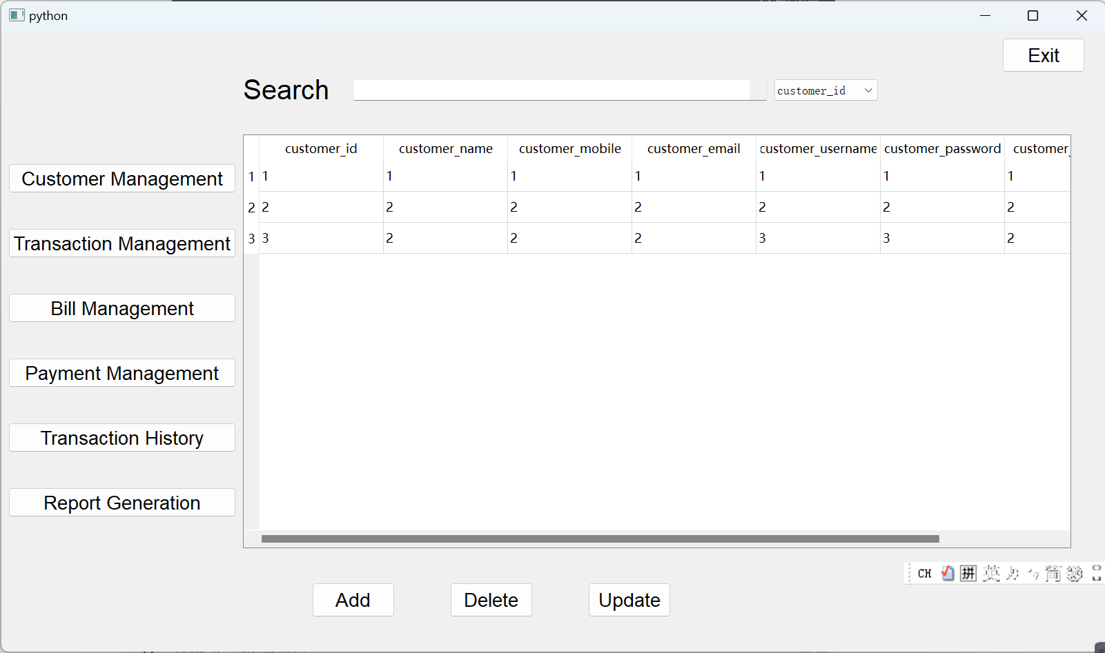
Notes:
Connect the button to the corresponding slot function.
Used to load different tabular data, export to Excel and close windows.

Slide 22
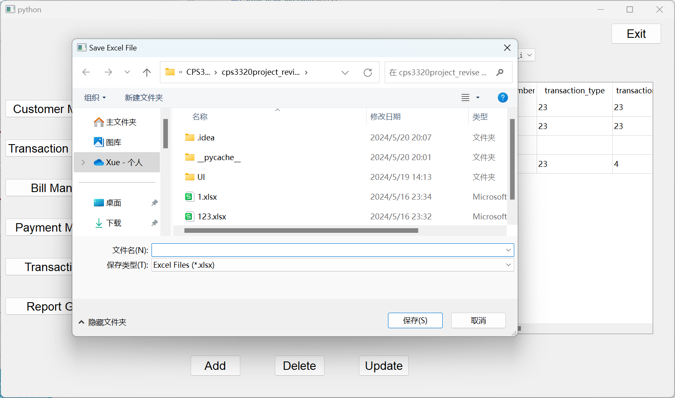
Notes:
Use QFileDialog to get the save file path, and call the adminManager method to write the data to the Excel file.
Instance of DatabaseManager

Slide 23
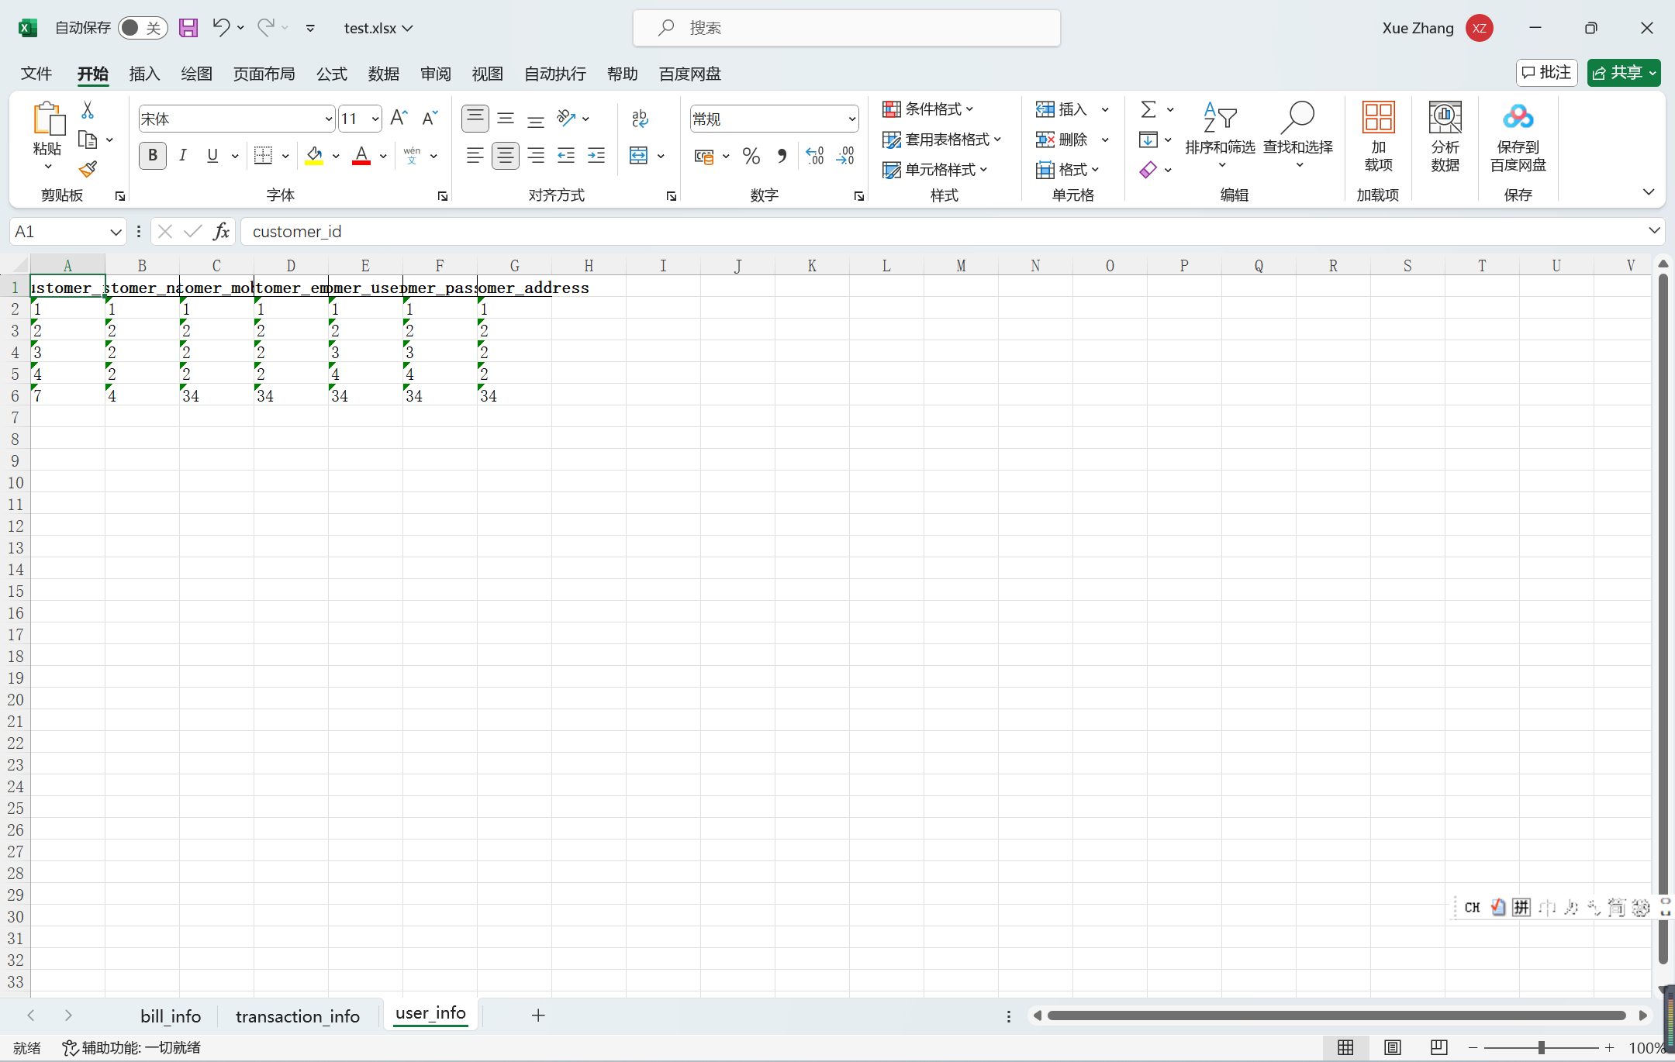
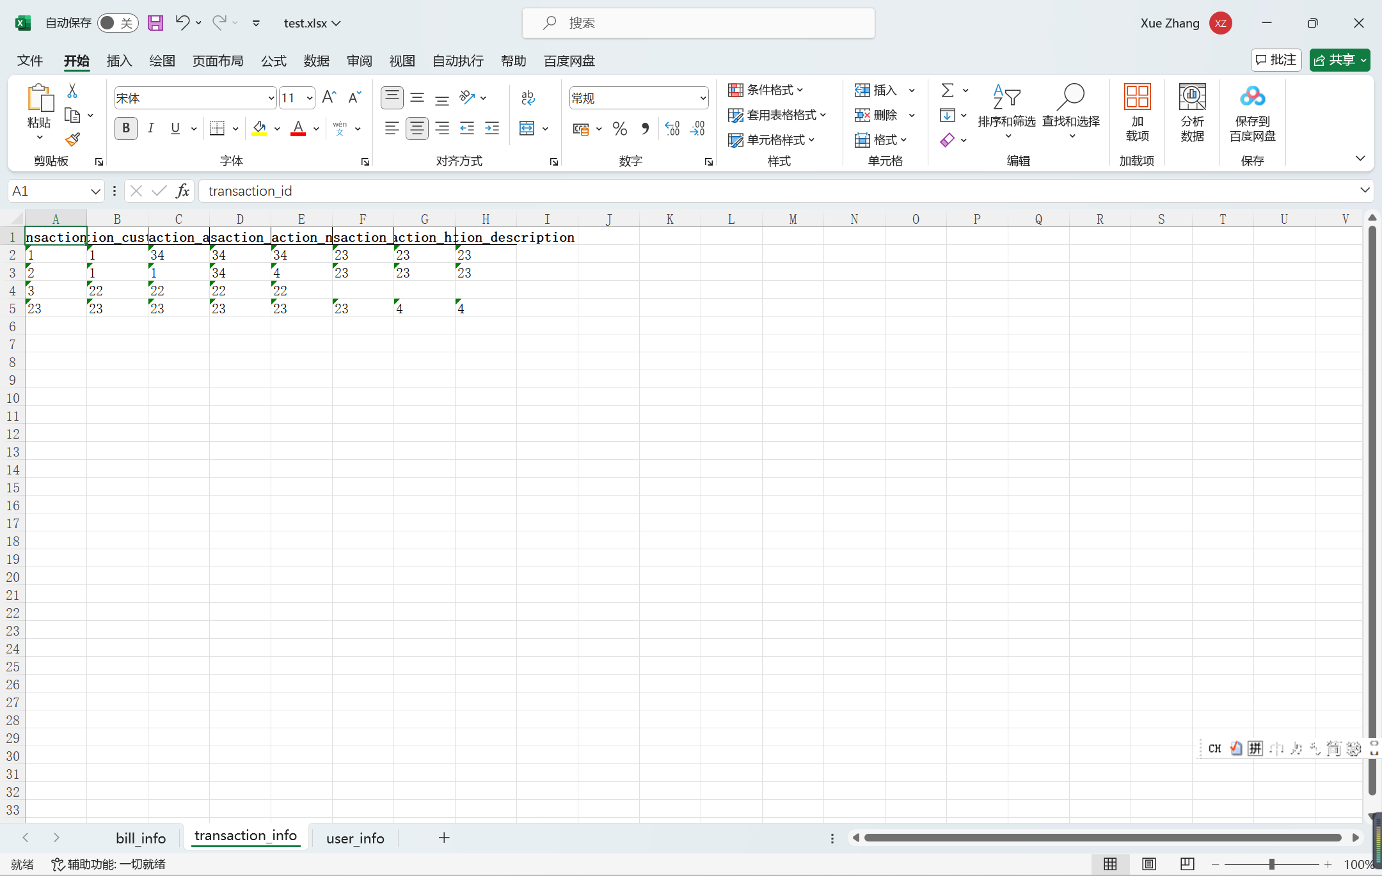
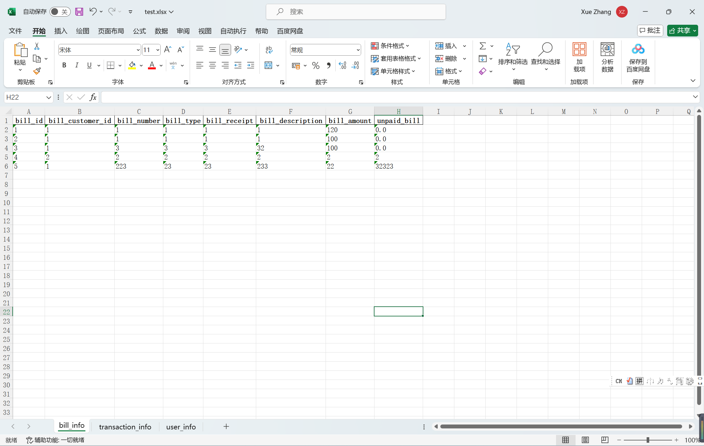

Slide 24
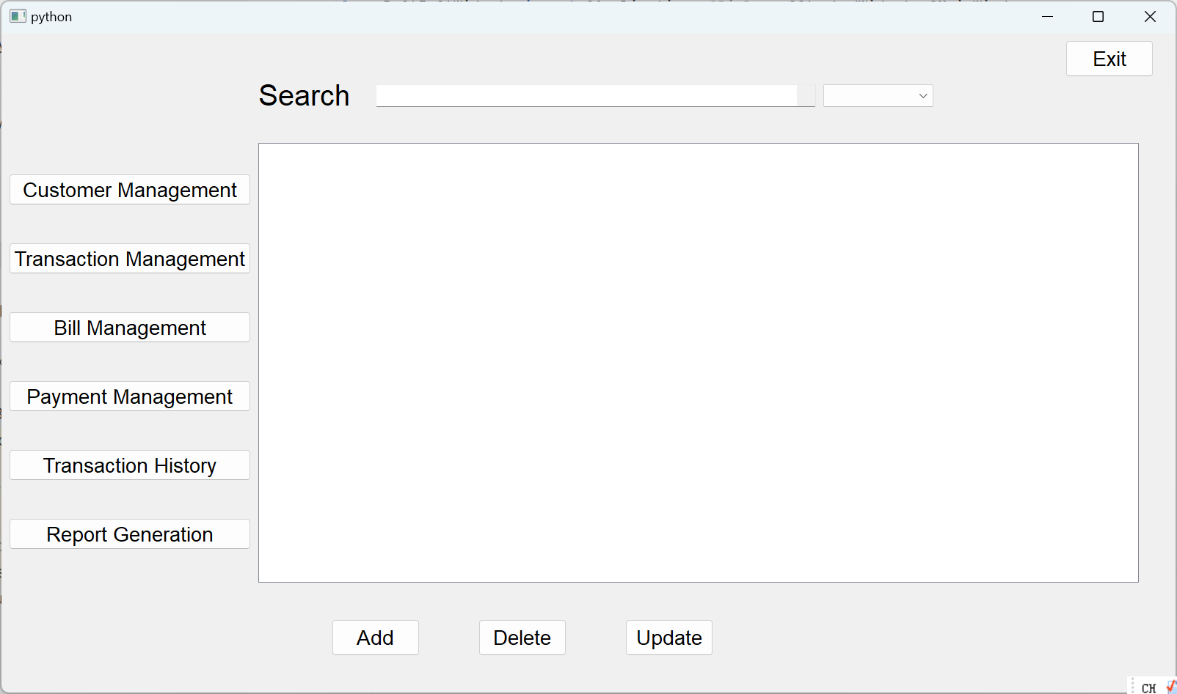
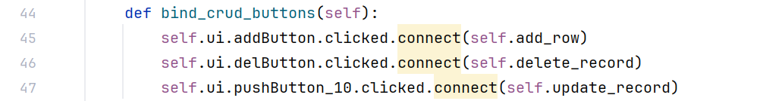
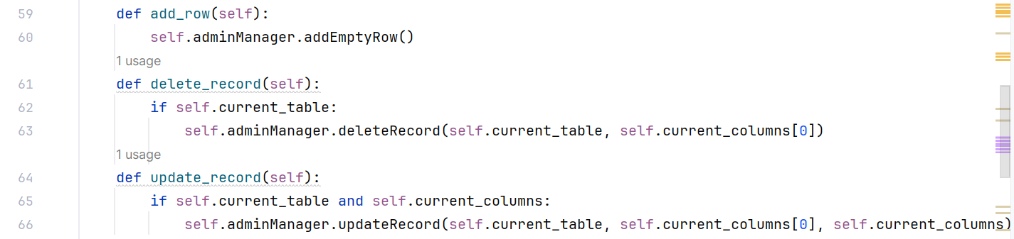
Notes:
Bind the corresponding slot functions to the add, delete and update buttons.

Slide 25
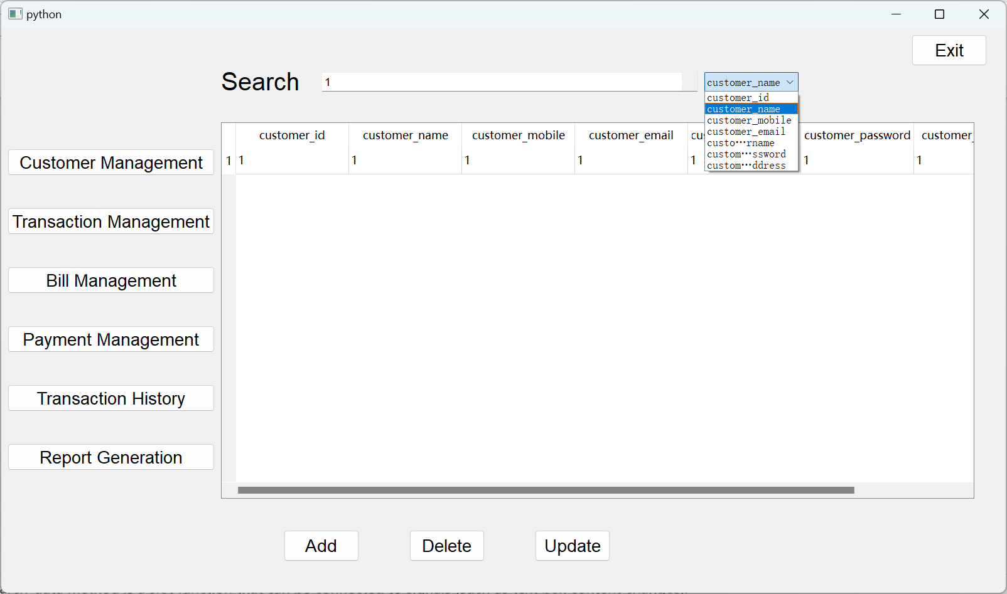
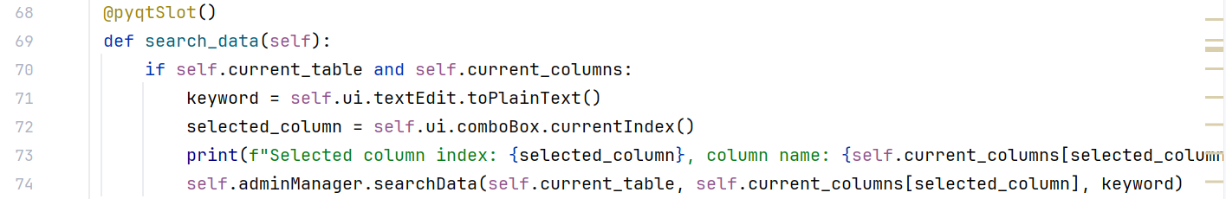
Notes:
（The search_data method is a slot function that can be connected to signals (such as text box content changes).
确保当前表和列信息已经被设置。只有在这些信息存在时才执行搜索操作。
从 textEdit 文本编辑框中获取用户输入的搜索关键字。
从 comboBox 下拉框中获取当前选中的列的索引。）
(槽函数在PyQt中扮演着处理事件响应的重要角色。通过将信号与槽函数连接起来，我们可以在用户交互时执行特定的操作，例如搜索数据、加载表格、处理支付等)
Call the searchData method of adminManager to search for keywords in the selected column of the current table.

Slide 26
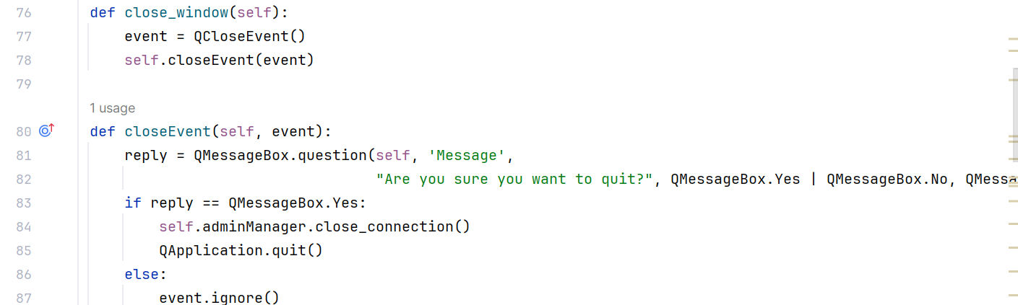
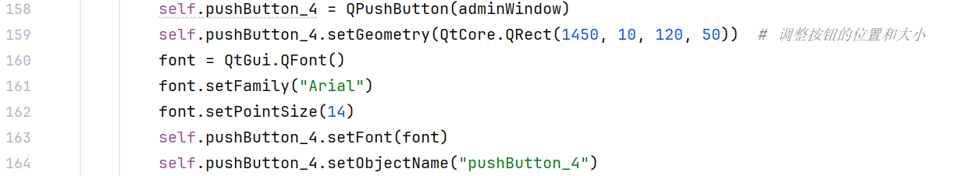
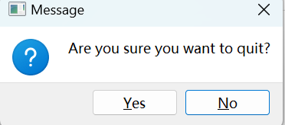
Notes:
（Explain how to handle window closing events.
Shows a confirmation dialog, and if the user confirms the exit, closes the database connection and ）
exits the application.

Slide 27
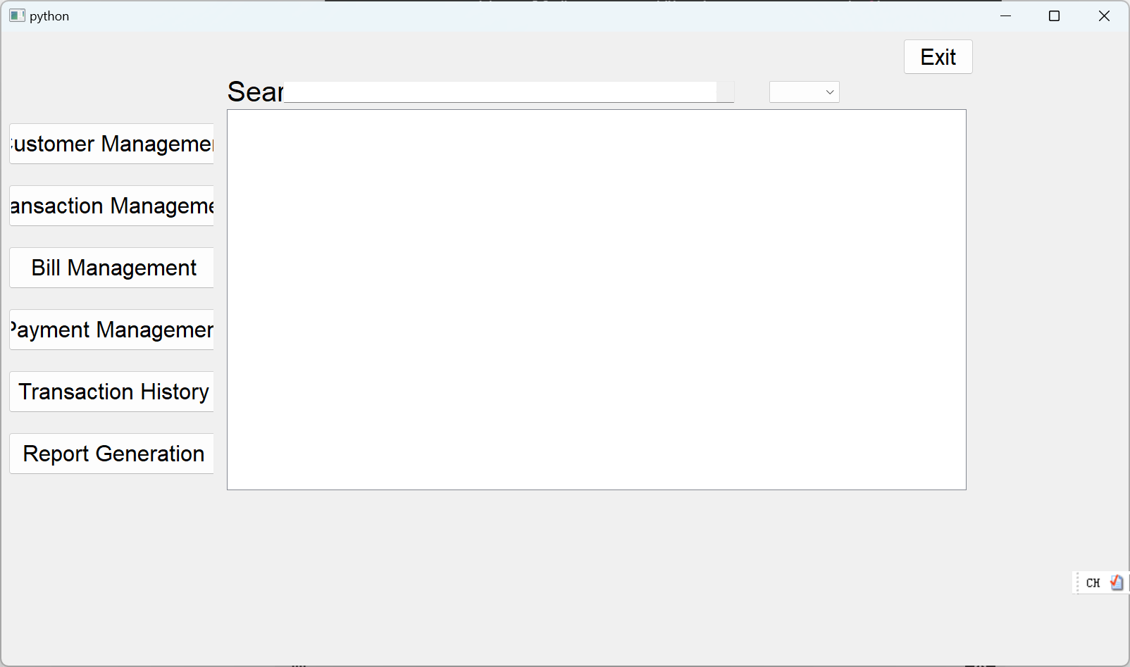
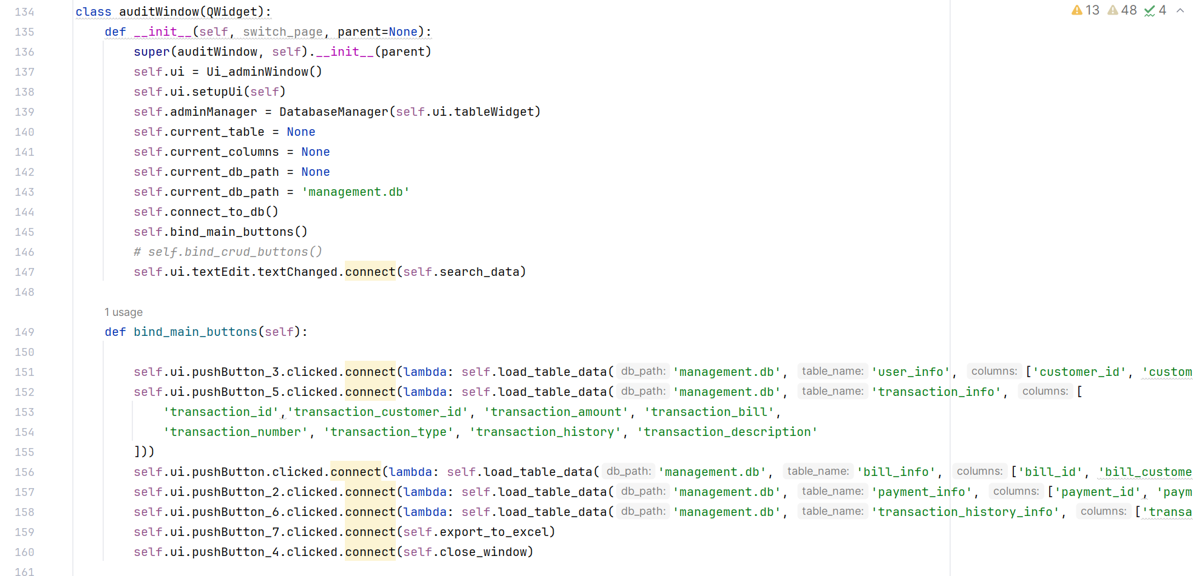
Audit class
Notes:
Users can switch between different data tables through buttons, and can search and export data.
Initialize the window, set up UI components, connect to the database, and bind button events.

Slide 28
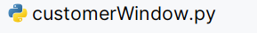
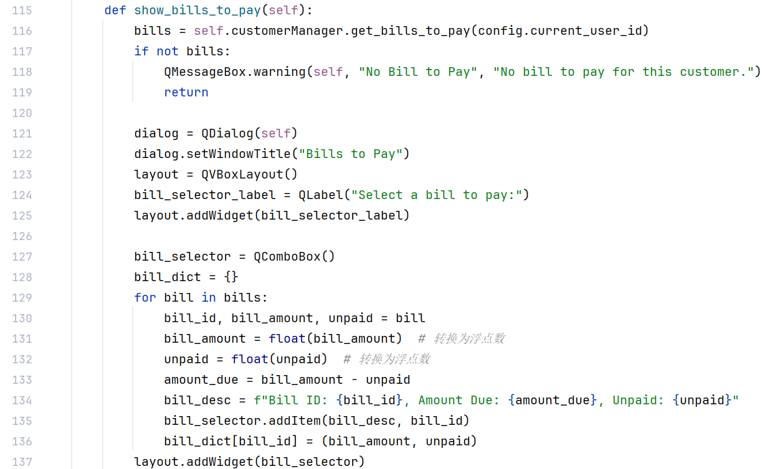
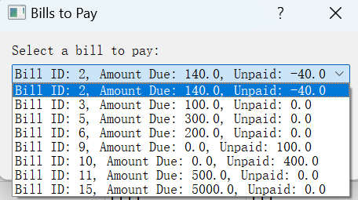
Notes:
show_bills_to_pay method: displays payable bills and provides a payment interface.
(获取当前用户需要支付的账单。
选择需要支付的账单
bill_selector.addItem(bill_desc, bill_id)：将账单描述信息和账单ID添加到下拉框中。
bill_dict[bill_id] = (bill_amount, unpaid)：将账单ID和相应的金额存储到字典中。
layout.addWidget(bill_selector)：将下拉框添加到布局中。
)

Slide 29
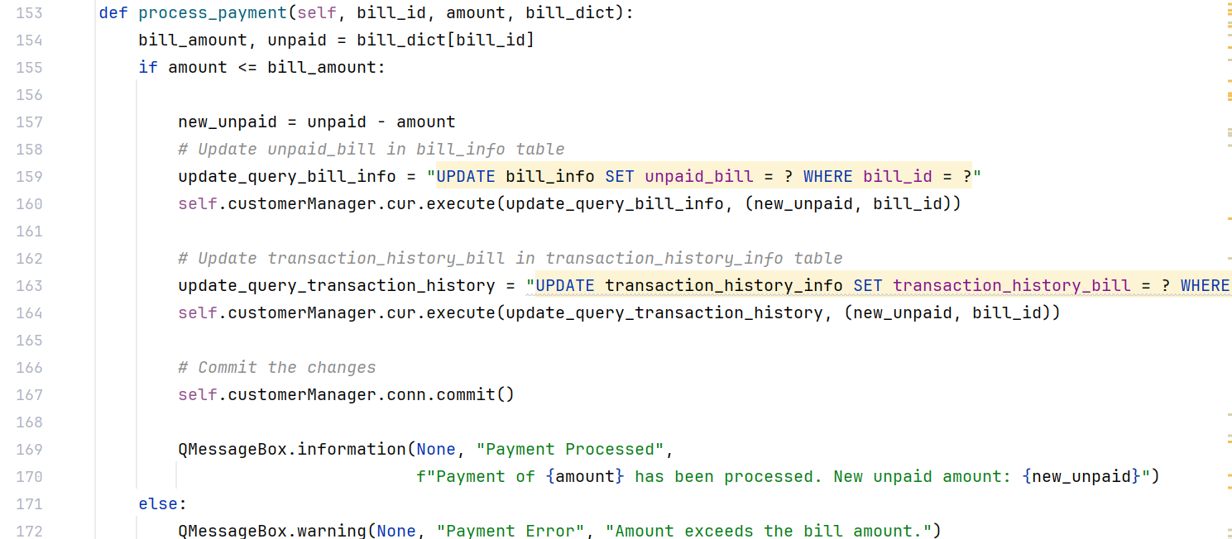
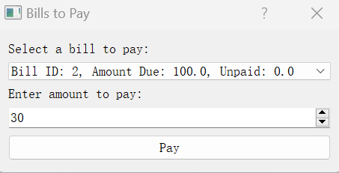
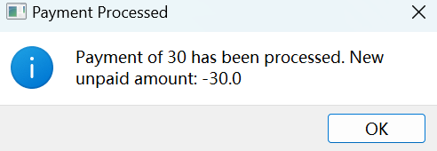
Notes:
process_payment method: Process payment operations and update billing and transaction history.
(
bill_amount, unpaid = bill_dict[bill_id]：从账单字典中获取账单总金额和未支付金额。
if amount <= bill_amount:：检查支付金额是否小于或等于账单总金额。
new_unpaid = unpaid - amount：计算新的未支付金额。
update_query_bill_info = "UPDATE bill_info SET unpaid_bill = ? WHERE bill_id = ?"：更新账单信息的SQL查询。
self.customerManager.cur.execute(update_query_bill_info, (new_unpaid, bill_id))：执行更新账单信息的SQL查询。
update_query_transaction_history = "UPDATE transaction_history_info SET transaction_history_bill = ? WHERE transaction_history_id = ?"：更新交易历史信息的SQL查询。
self.customerManager.cur.execute(update_query_transaction_history, (new_unpaid, bill_id))：执行更新交易历史信息的SQL查询。
self.customerManager.conn.commit()：提交事务，保存更改。
QMessageBox.information(None, "Payment Processed", f"Payment of {amount} has been processed. New unpaid amount: {new_unpaid}")：显示支付成功的消息框。
else:：如果支付金额大于账单总金额，显示错误消息框。
QMessageBox.warning(None, "Payment Error", "Amount exceeds the bill amount.")：显示支付错误的消息框。
)
# 打开命令行并导航到数据库文件所在目录
cd path/to/your/database
# 启动 sqlite3 并打开数据库
sqlite3 management.db
# 插入数据
INSERT INTO users (user, password, perm) VALUES ('admin', 'admin_password', 1);
INSERT INTO user_info (customer_id, customer_username, customer_password) VALUES (1, 'admin', 'admin_password');
# 验证数据插入
SELECT * FROM users;
SELECT * FROM user_info;
# 退出 sqlite3
.quit

Slide 30
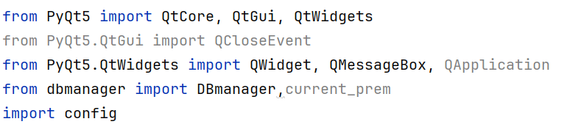
Notes:
Import module
QtCore, QtGui, and QtWidgets are PyQt5 modules used for creating GUI applications.
QCloseEvent, QWidget, QMessageBox, QApplication are used to handle window close events, widgets, message boxes and application management.
DBmanager is a custom module that handles database operations.
The config module is used to store global configuration.

Slide 31
Research importance
Task allocation in heterogeneous systems is a non-trivial issue that necessitates intricate algorithmic approaches, crucial for enhancing the efficiency of computational resources across diverse applications. This research endeavors to explore advanced scheduling algorithms within such environments. This investigation scrutinizes the comparative efficiency of three pivotal algorithms—HEFT, PPTS, and IPPTS.

Slide 32
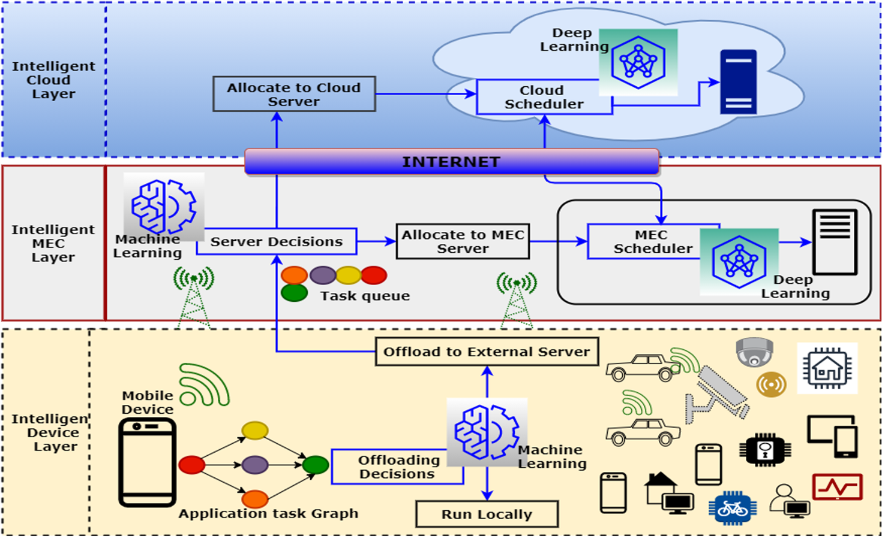
Background
Intelligent Cloud Layer
Leveraging advanced analytics techniques
Intelligent MEC Layer
The tasks are queued up in order to be processed
添加标题
添加标题
添加标题
添加标题
添加标题
添加标题
Intelligent Device Layer
添加标题
添加标题
添加标题
Generate various computing tasks
添加标题
添加标题
添加标题
Notes:
a layered architecture for task scheduling and resource allocation
1.The task starts on the user's smart device, such as a smartphone or other IoT device. Applications on these devices generate various computing tasks, which may be data analysis, image processing, etc. Each task is evaluated by a machine learning model to decide whether it should be executed locally or uploaded to a more powerful server.
2. When tasks arrive at the MEC ("Mobile Edge Computing) server or cloud server, they are placed in a task queue. The task queue is like a waiting area, ensuring that all tasks are queued up in order to be processed.
3. cloud layer is at the top of this architecture and has more powerful processing capabilities. It is capable of handling computationally intensive tasks from below, leveraging advanced analytics techniques such as deep learning for data processing and decision support.
下面是具体的解释：
This figure shows a multi-layered intelligent task scheduling architecture for scheduling tasks between the cloud layer, edge computing layer (MEC), and device layer. This research mainly focuses on the edge computing layer (MEC) and the cloud layer. These scheduling algorithms mainly focus on how to efficiently allocate tasks in heterogeneous computing environments. The scheduling algorithm attempts to minimize the total time to complete all tasks (makespan). By predicting the completion time of each task and its dependencies, the scheduler can allocate tasks more intelligently, reduce waiting time, and improve overall efficiency.
Scheduler: The scheduler is not a specific processor or server, but an algorithm running on the server that is responsible for deciding which task should be executed by which processor. The scheduler evaluates each task's requirements and the status of available processors, then assigns the task to the most appropriate processor. For example, a task that requires a lot of GPU resources might be assigned to a server with corresponding hardware.

Slide 33
Methods
HEFT:
Sort tasks based on upward ranking value (rank_u).
Choose the processor with the smallest earliest completion time (EFT).
PPTS:
Determine task sequencing using the Predictive Cost Matrix (PCM).
Combine EFT and PCM values for processor selection.
IPPTS:
Use predicted ranking values (Prank) to further optimize task order.
Use Lheadeft to consider the forward and backward costs of the task and select the processor.
Notes:
The algorithms introduce a two-phase approach: task prioritization and processor selection, aiming to minimize the scheduling length.
The HEFT algorithm optimizes task scheduling by considering the earliest completion time of each task and the performance of the processor. In a cloud tier environment, it allocates tasks to servers that can complete those tasks fastest.
The PPTS algorithm adds a predictive cost matrix (PCM) based on HEFT, which can more accurately estimate the data transmission cost and processing time between tasks.
(In the cloud, this predictive analytics can help schedulers allocate resources more efficiently, especially when tasks have complex dependencies.)
3. A unique feature is its ability to "look ahead" by considering the "out-degree" of tasks during the prioritization phase and adopting a "downward-upward" approach during the processor selection phase.

Slide 34
II HEFT
Notes:
handling the variability in performance across different processors.

Slide 35
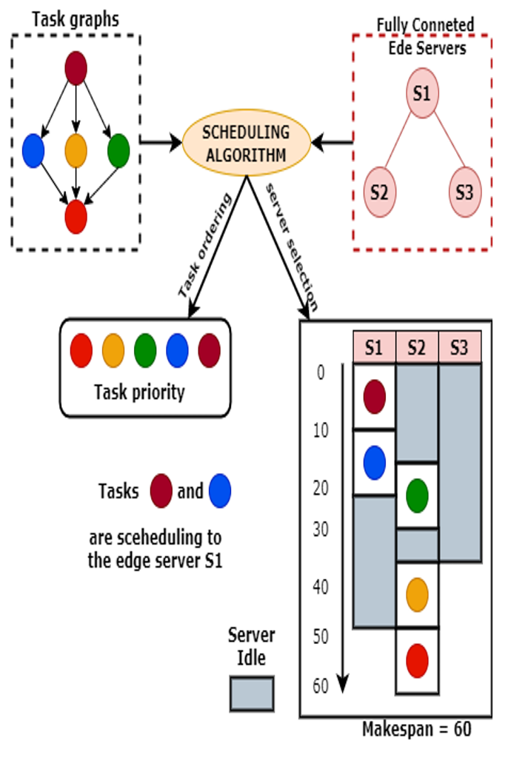
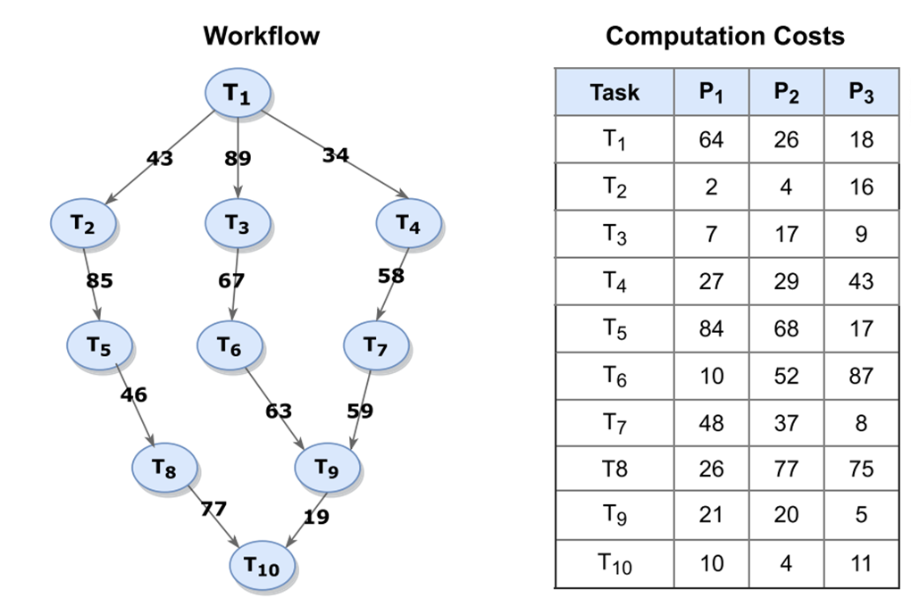
Notes:
（Both DAG (directed acyclic graph) and computational cost are part of the core of the HEFT algorithm.）
dag represents the dependency between tasks, and computation_costs is the execution time of each task on different processors.

Slide 36
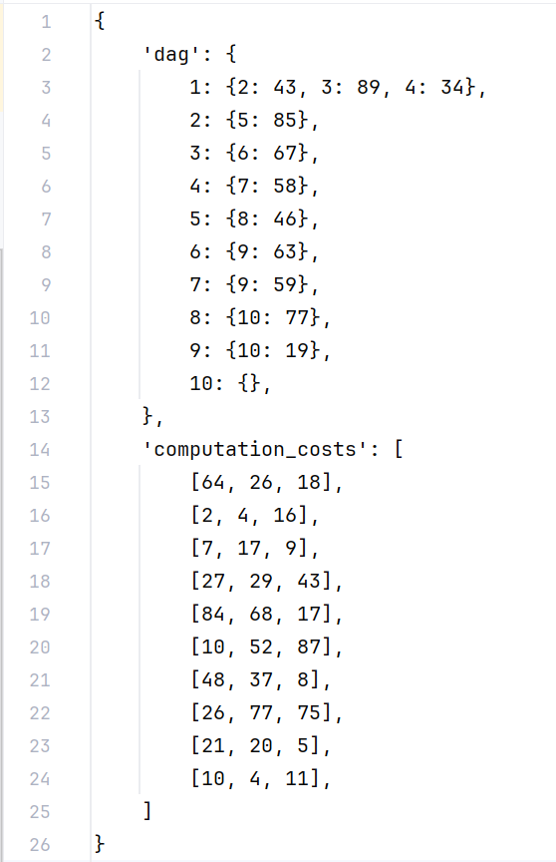
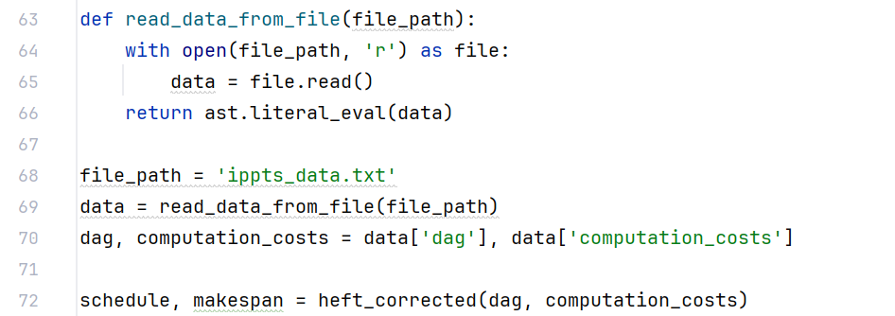
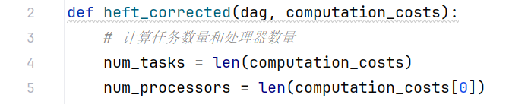
Notes:
（This structure facilitates subsequent quick access to the communication costs between any two tasks when calculating the upward ranking of tasks.）

Slide 37
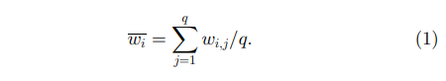
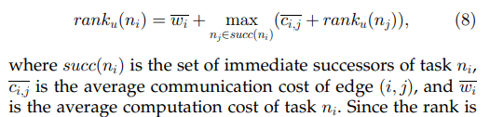
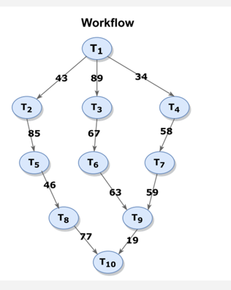
I Task prioritization phase
Notes:
Calculate the average c c of the task on 3 processors

Slide 38
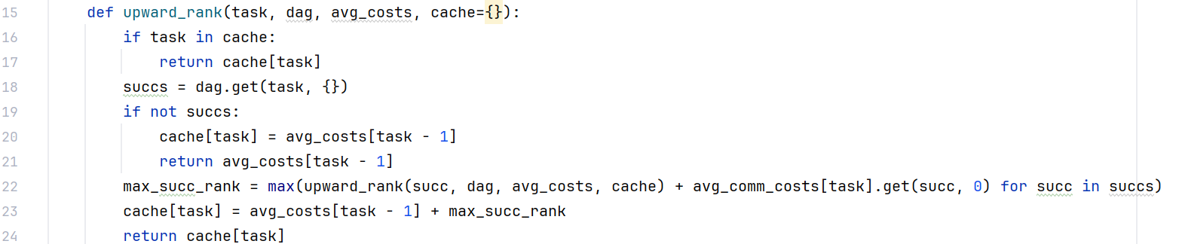

Notes:
- The function is designed to be called recursively.
- It checks if the current task's upward rank has already been calculated and stored in a cache. If so, it returns the cached value (to avoid redundant calculations.)
- If the task is not in the cache, the function looks for successor tasks in the DAG that depend on the current task.
If there are no successors, the function stores the task’s average computation cost in the cache and returns it.
(The average costs are given by the `avg_costs` list, indexed by one less than the task number.)
- If there are successors, the function calculates the maximum of the sums of the upward rank of each successor and the average communication cost from the current task to that successor. (The `avg_comm_costs` dictionary contains these communication costs.)
- The upward rank of the current task is then determined by adding its own average computation cost to the maximum sum calculated from its successors.
(存储已经计算过的任务的排名。这样可以避免重复计算同一个任务的向上排名，提高效率，大量任务和复杂依赖关系的DAG
succ →从 dag 中获取当前任务 task 的所有后继任务
if not succs → 如果当前任务没有后继任务，说明它是终端任务。此时，其向上排名就是其自身的平均计算成本。因为没有后继任务，所以不需要考虑后继任务的影响。计算结果被保存到缓存中，并返回。
计算当前任务的所有后继任务的最大排名值。对于每一个后继任务 。加上从当前任务 task 到后继任务 succ 的通信成本。
自身的平均计算成本加上其所有后继任务中的最大排名值，并将这个结果保存到缓存中。)

Slide 39
Descending order of ranking
Notes:
After computing the "upward rank" of a task, then we perform them in descending order of ranking, tasks with higher rankings will be given priority.
(由于 cache 在函数定义中被设定为默认参数，其默认值是一个空字典 {}，因此在调用 upward_rank 函数时不显式提供这个参数也是可行的。
Performed in descending order of ranking, tasks with higher rankings (i.e. those with greater computational and communication costs) will be given priority.
(HEFT试图尽早完成那些对整体工作流完成时间影响最大的任务HEFT attempts to complete those tasks as early as possible that have the greatest impact on the overall workflow completion time。)

Slide 40


II Processor Selection Phase
Notes:
At this stage, we need to assign a processor to each task in the task list previously sorted by upward ranking and calculate the EFT of the task
(在这一阶段，我们需要为之前按照向上排名排序的任务列表中的每个任务分配一个处理器，并计算任务的最早完成时间（EFT）
succ and EFT
每个处理器上最后一个任务的结束时间 The end time of the last task on each processor)

Slide 41

Notes:
We iterate through each task, checking each processor through the inner loop, and calculate the EST and EFT if the task is executed on that processor.
After calculating the EFT, we select the processor that gives the minimum EFT
(Next, we iterate through each task, checking each processor through an inner loop, and calculating the earliest start time (EST) and early finish time (EFT) if the task is executed on that processor.
In particular, if a task has a front-loading dependency that has been completed on other processors, we need to add the communication time to determine the true EST. After calculating the EFT, we choose the processor that gives the minimum EFT)

Slide 42


Slide 43
III PPTS

Slide 44

Task Prioritizing phase
Notes:
HEFT focuses primarily on minimizing EFT without considering the global impact of task ordering
PPTS introduces a novel approach by incorporating a lookahead feature
(in both the task prioritizing and processor selection phases)
(to evaluate the costs, which allows for prioritizing tasks based on their future impact on the schedule, thus maintaining a global perspective from the start)

Slide 45

Notes:
exit task (记录当前任务到终点的最大pc)

Slide 46



Notes:
the code is calculating the estimated maximum execution cost for a given task on a given processor, considering both the computation costs of the task itself and its successors, as well as communication costs between tasks scheduled on different processors.
This cost is then stored in a matrix that is likely used to guide the task scheduling decisions to minimize the total execution time of all tasks.
(if processor of succ_task != processor of current task
+cc
if they are in the same processor, then +0
(因为如果两个任务在同一个处理器上执行，它们之间的数据传输通常不需要额外成本，或者成本可以忽略不计。)
(else 0: 如果后继任务和当前任务在同一个处理器上执行，那么通信成本为0。
(Ensure that max_cost remains the maximum predicted cost on the path from the current task to all successor tasks.)

Slide 47



Slide 48
PPTS —— Task Prioritizing phase

Slide 49
What does priority composed of
rank_{pcm} decides Priority
rank_{pcm}
Priority

Slide 50

About rank_{pcm}
Rank_{pcm} is used to get the task’s priority
Rank_{pcm} is the average PCM in all the processors

Slide 51


About rank_{pcm}
From this graph, we can see the difference between PPTS and HEFT:
PPTS
HEFT
The tasks priority list by rank_{pcm} is:
{T₁, T₆, T₂, T₃, T₄, T₅, T₈, T₇, T₉, T₁₀}
The tasks priority list by rank_{u} is:
{T₁, T₅, T₆, T₂, T₄, T₃, T₈, T₇, T₉, T₁₀}

Slide 52
PPTS —— Processor Selection phase
●EST, EFT, AFT ●LA_{eft}

Slide 53

About EST, EFT, AFT
EST: The earliest execution start time
EFT: The earliest execution finish time
AFT: The actual finish time

Slide 54




About EST, EFT, AFT
Back
Order:
We use these two graphs to explain it:

Slide 55

About LA_{eft}
downward
upward
It has a big difference between HEFT and PPTS in this phase
HEFT: compute the priority of each task by EFT
PPTS: compute the priority of each task by LA_{EFT}

Slide 56
About EST, EFT, AFT
Back
Order:
We use these two graphs to explain it:

Slide 57



Program

Slide 58

IPPTS —— Task Prioritization Phase
● Prank

Slide 59


About Prank
outd: the number of immediate successor tasks
Prank: computing the predicted rank
Advantage:
consider downward and the out-degree at the same time

Slide 60
IPPTS —— Processor Selection Phase
● LHET ● Lhead_{eft}

Slide 61


About LHET
LHEF: The Longest Distance Exit time
PCM: The greatest element of the shortest paths from task t_{i} to the exit task
i
c_{i,k}
k
0

Slide 62
About Lhead_{eft}
downward
upward
compare
Lhead_{eft}: Looking Ahead Earliest Finish Time

Slide 63



Program

Slide 64
Conclusion
HEFT
PPTS
IPPTS

Slide 65




Compare
HEFT
PPTS
IPPTS

Slide 66

Compare
HEFT
PPTS
IPPTS

Slide 67
Compare
HEFT: Consider about downward (uses EFT accumulate to get AFT, and compare)
PPTS: Consider both upwards and downwards
The Task Prioritization Phase: PCM
The Processor Selection Phase: LA_{eft}
IPPTS:
Take immediate successors into consideration (Prank)
Exclude the influence of the current node (LHET)

Slide 68


Slide 69
Thank You For Listening

Slide 70


Slide 71





Slide 72





